Slide 1


Mobile Learning Application Development
Presented By:
Rakib Hossen
Assistant Professor
Dept. of Cyber Security Engineering (CySE), GDU

Slide 2




Introduction
In general, creating a mobile application is a very complex and challenging task. There are many frameworks available, which provide excellent features to develop mobile applications.
For developing mobile apps, Android provides a native framework based on Java and Kotlin language, while iOS provides a framework based on Objective-C/Swift language.
Thus, we need two different languages and frameworks to develop applications for both OS.
To overcome form this complexity, there are several frameworks have introduced that support both OS along with desktop apps.
These types of the framework are known as cross-platform development tools.

Slide 3



Introduction
The cross-platform development framework has the ability to deploy on the various platform (Android, iOS, and Desktop).
write one code and can
It saves a lot of time and development efforts of developers. There are several tools available for cross-platform development, including web-based tools, such as Ionic from Drifty Co. in 2013, Phonegap from Adobe, Xamarin from Microsoft, and React Native from Facebook.
Each of these frameworks has varying degrees of success in the mobile industry.
In recent, a new framework has introduced in the cross- platform development family named Flutter developed from Google.

Slide 4

What is Flutter?
Flutter is a UI toolkit for building fast, beautiful, natively compiled applications for mobile, web, and desktop with one programing language and single codebase.
It is free and open-source. Initially, it was developed from Google and now manages by an ECMA standard.
Flutter apps use Dart programming language for creating an app.
The first version of Flutter was announced in the year 2015 at the Dart Developer Summit.
It was initially known as codename Sky and can run on the Android OS. On December 4, 2018, the first stable version of the Flutter framework was released, denoting Flutter 1.0.
The current stable release of the framework is Flutter v3.24 on August 07, 2024.

Slide 5
What is Flutter?
Flutter apps use Dart programming language for creating an app.
The dart programming shares several same features as other programming languages, such as Kotlin and Swift, and can be trans-compiled into JavaScript code.
Flutter is mainly optimized for 2D mobile apps that can run on both Android and iOS platforms.
We can also use it to build full-featured apps, including camera, storage, geolocation, network, third-party SDKs, and more.

Slide 6

What makes Flutter unique?
Flutter is different from other frameworks because it neither uses WebView nor the OEM widgets that shipped with the device.
Instead, it uses its own high-performance rendering engine to draw widgets.
It also implements most of its systems such as animation, gesture, and widgets in Dart programing language that allows developers to read, change, replace, or remove things easily.
It gives excellent control to the developers over the system.

Slide 7
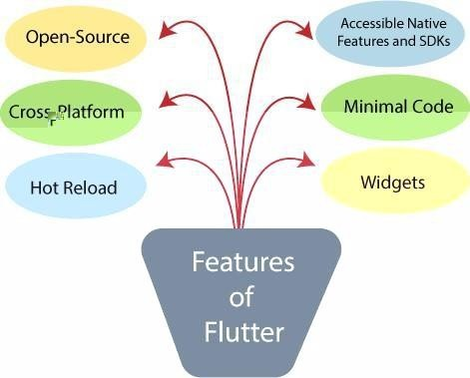
Features

Slide 8

Advantages
It makes the app development process extremely fast because of the hot-reload feature. This feature allows us to change or update the code are reflected as soon as the alterations are made.
It provides the smoother and seamless scrolling experiences of using the app without much hangs or cuts, which makes running applications faster in comparison to other mobile app development frameworks.
Flutter reduces the time and efforts of testing. As we know, flutter apps are cross-platform so that testers do not always need to run the same set of tests on different platforms for the same app.
It has an excellent user interface because it uses a design-centric widget, high-development tools, advanced APIs, and many more features.

Slide 9
Advantages
It is similar to a reactive framework where the developers do not need to update the UI content manually.
It is suitable for MVP (Minimum Viable Product) apps because of its speedy development process and cross-platform nature.

Slide 10

Disadvantages
The Flutter is a comparatively new language that needs continuous integration support through the maintenance of scripts.
It provides very limited access to SDK libraries. It means a developer does not have a lot of functionalities to create a mobile application. Such types of functionalities need to be developed by the Flutter developer themselves.
The Flutter apps do not support the browser. It only supports Android and iOS platforms.
It uses Dart programming for coding, so a developer needs to learn new technologies. However, it is easy to learn for developers.

